Slide 1



ENABLING, MANAGING AND CONTROLLING EXTERNAL AND GUEST ACCESS IN MICROSOFT TEAMS AND AAD by Adis Jugo TEAMS CONSULTING, CEO AND LEAD ARCHITECT MICROSOFT MVP, MICROSOFT REGIONAL DIRECTOR
collabdays | lisbon
October 10th, 2020

Slide 2









Our Sponsors
DIAMOND
COMMUNITY

Slide 3
AGENDA
MANAGING GUESTS
6
GUEST INVITATION AND LOGIN FLOW
AUDITING GUESTS
5
3
4
2
EXTERNAL AND GUEST USERS
CONFIGURING GOOGLE FEDERATION
CONFIGURING GUEST AND EXTERNAL ACCESS
1

Slide 4
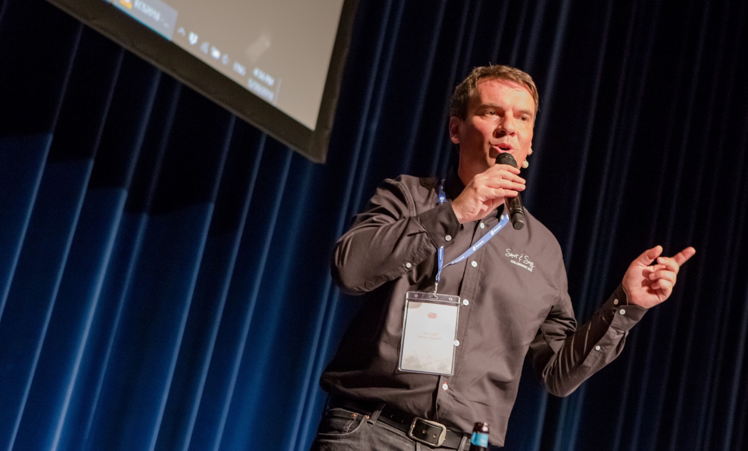
Adis Jugo
CEO and Founder of Nubelus (www.nubelus.com)
CEO and founder of Teams Consulting (www.teamsconsulting.eu)
Firmly believes in leading people by trust and example
Microsoft Regional Director
Microsoft MVP Office Apps and Services
Microsoft MVP Azure
Mastermind behind European Collaboration Summit (www.collabsummit.eu)
Mastermind behind European Cloud Summit (www.cloudsummit.eu)
Editor in chief of #COLLABMAGAZINE (www.collabmagazine.com)
In IT for way too long (first money earned with development back in 1991)
Born in Sarajevo, Bosnia, living in Bingen, Germany
Speaker, author. adisjugo.com
Notes:
VS 2013 with console
VS 2013 empty
VS 2012 with WP emulator
SP Designer
Microsoft Azure (IE)
Win Dev Portal (IE)
Dev site (Chrome)

Slide 5


Slide 6


Slide 7

LET’S GO
UNDERSTANDING GUEST AND EXTERNAL USERS AUTHENTIFICATION AND PRIVILEGES SETTINGS

Slide 8










EXTERNAL ACCESS GUEST ACCESS
TENANT A
TENANT A
GUEST USR 1
GUEST USR 2
TENANT B
S4B
SKYPE
TENANT B
MS ACCNT

Slide 9
External access vs Guest access privileges
Feature | External | Guest
User can chat with someone in another company | Yes | Yes
User can call someone in another company | Yes | Yes
User can see if someone from another company is available for call or chat | Yes | Yes
User can search for users across external tenants | Yes | No
User can share files | No | Yes
User can access Teams resources | No | Yes
User can be added to a group chat | No | Yes
User can be invited to a meeting | Yes | Yes
Additional users can be added to a chat with an external user | No | N/A
User is identified as an external party | Yes | Yes
Presence is displayed | Yes | Yes
Out of office message is shown | No | Yes
Individual user can be blocked | No | Yes
@mentions are supported | Yes | Yes
Make private calls | Yes | Yes
View the phone number for dial-in meeting participants | No | Yes
Allow IP video | Yes | Yes
Screen sharing mode | Yes | Yes
Allow meet now | No | Yes
Edit sent messages | Yes | Yes
Can delete sent messages | Yes | Yes
Use Giphy in conversation | Yes | Yes
Use memes in conversation | Yes | Yes
Use stickers in conversation | Yes | Yes

Slide 10
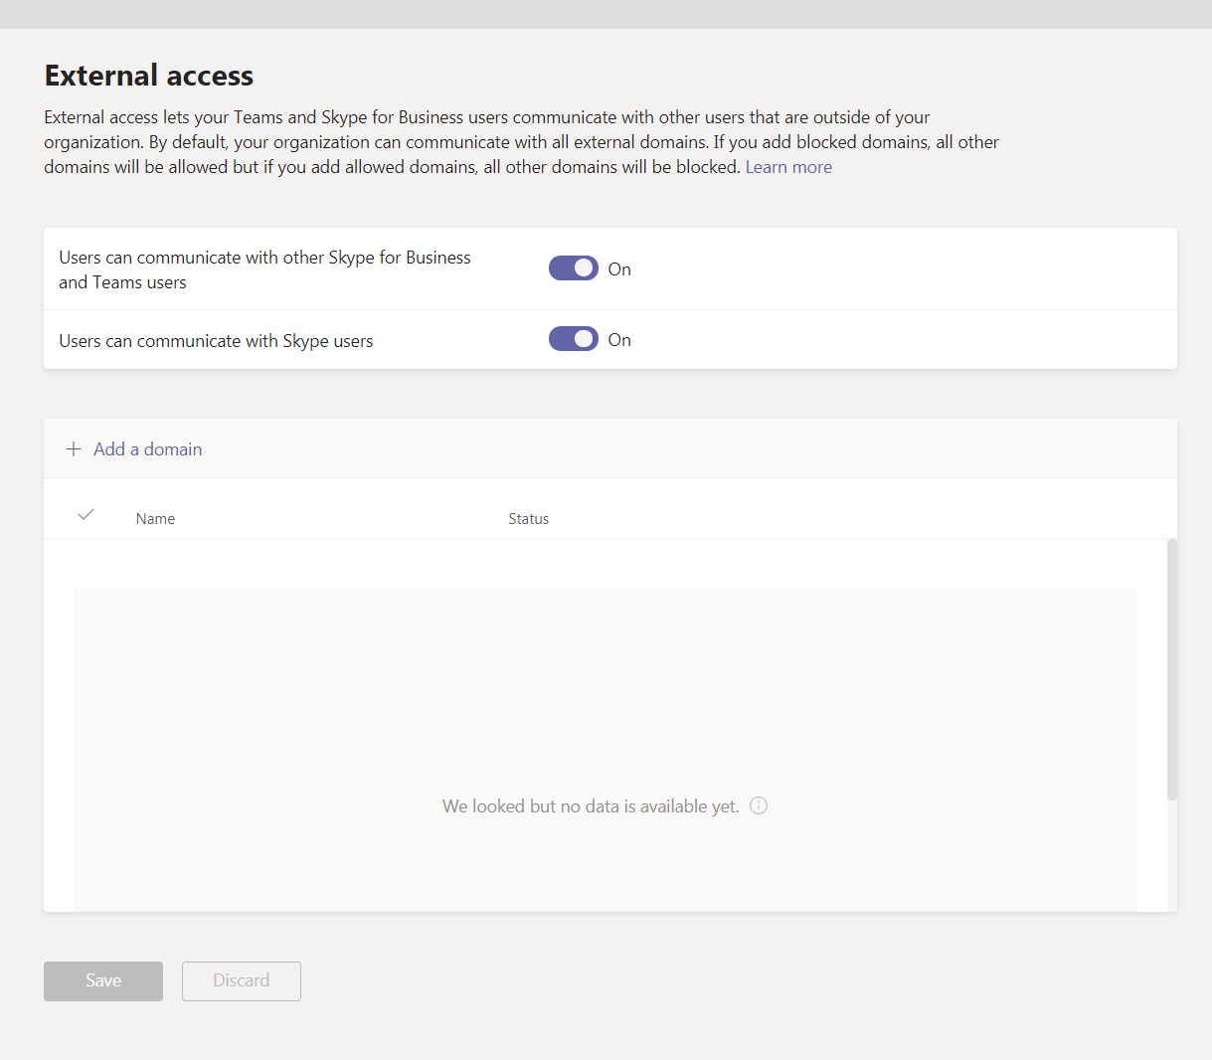
How do I control external access?
By default, external access is turned on in Teams, which means that your organization can communicate with all external domains. If you add blocked domains, all other domains will be allowed; and if you add allowed domains, all other domains will be blocked.
Teams Admin Center -> Org Wide Settings
Import-Module SkypeOnlineConnector $Cred = Get-Credential $CSSession = New-CsOnlineSession -Credential $Cred Import-PSSession -Session $CSSession
Get-CsTenantFederationConfiguration

Slide 11


GUEST ACCESS
TENANT A
GUEST USR 1
GUEST USR 2
GUEST USR 2
TENANT B
MS ACCNT
GOOGLE

Slide 12
TEAM MEMBERS VS GUESTS
Capability | User | Guest
Create a channel | ✓ | ✓
Participate in a private chat | ✓ | ✓
Participate in a channel conversation | ✓ | ✓
Post, delete, and edit messages | ✓ | ✓
Share a channel file | ✓ | ✓
Share a chat file | ✓
Add apps (tabs, bots, or connectors) | ✓
Create meetings or access schedules | ✓
Access OneDrive for Business storage | ✓
Create tenant-wide and teams/channels guest access policies | ✓
Invite a user outside the Office 365 organization's domain | ✓
Create a team | ✓
Discover and join a public team | ✓
View organization chart | ✓
Use inline translation | ✓
Become team owner | ✓

Slide 13
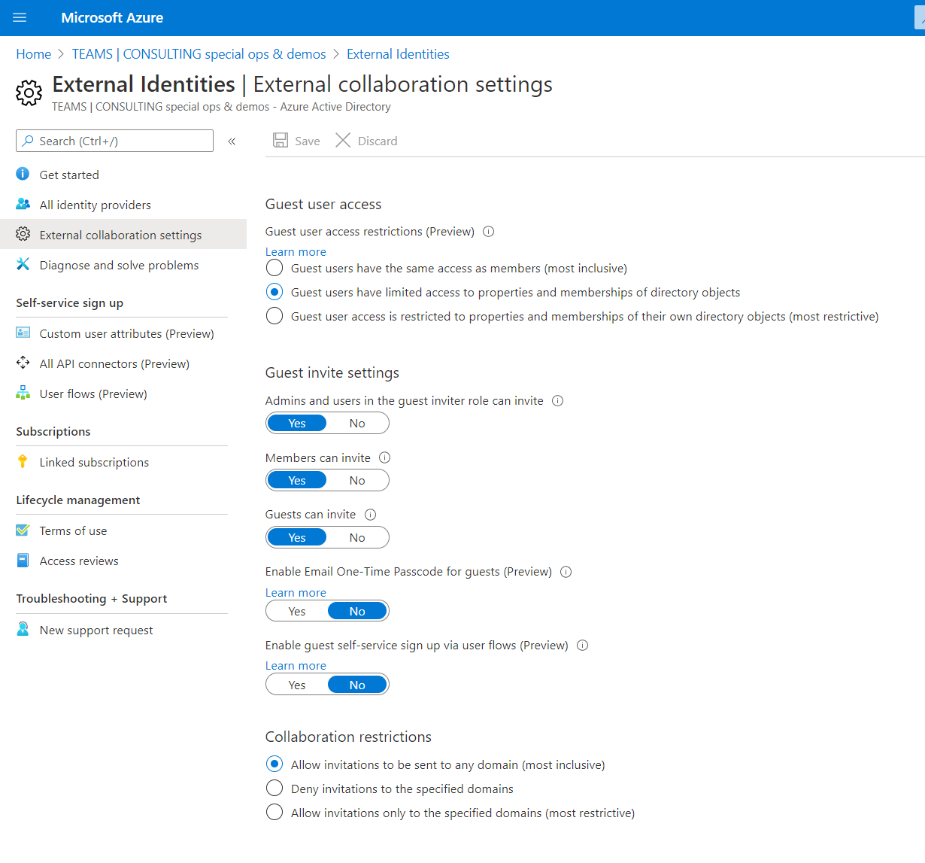
Enabling guest access: Step 1 – Azure Active Directory
AAD -> External Identities -> External Collaboration Settings

Slide 14
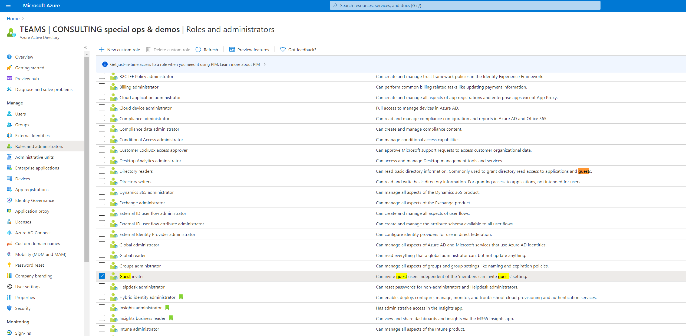
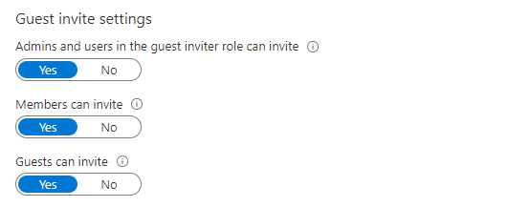
Enabling guest access: Azure – setting up a Guest Inviter Role
AAD -> Roles and administrators
Get-AzureADDirectoryRole
Get-AzureADDirectoryRoleMember -ObjectID "3e85b909-4d3c-4618-b294-e55f0e42fb17“
Add-AzureADDirectoryRoleMember -ObjectId “****" -RefObjectId “****"

Slide 15
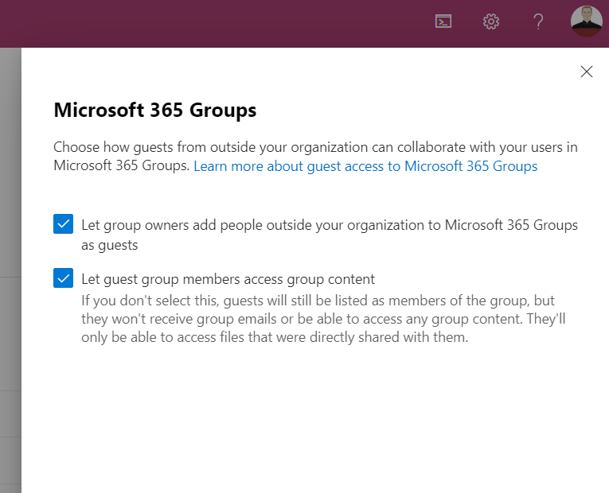
Enabling guest access: Step 2 – Check Office 365 Groups Settings
Settings -> Org settings -> Microsoft 365 Groups

Slide 16
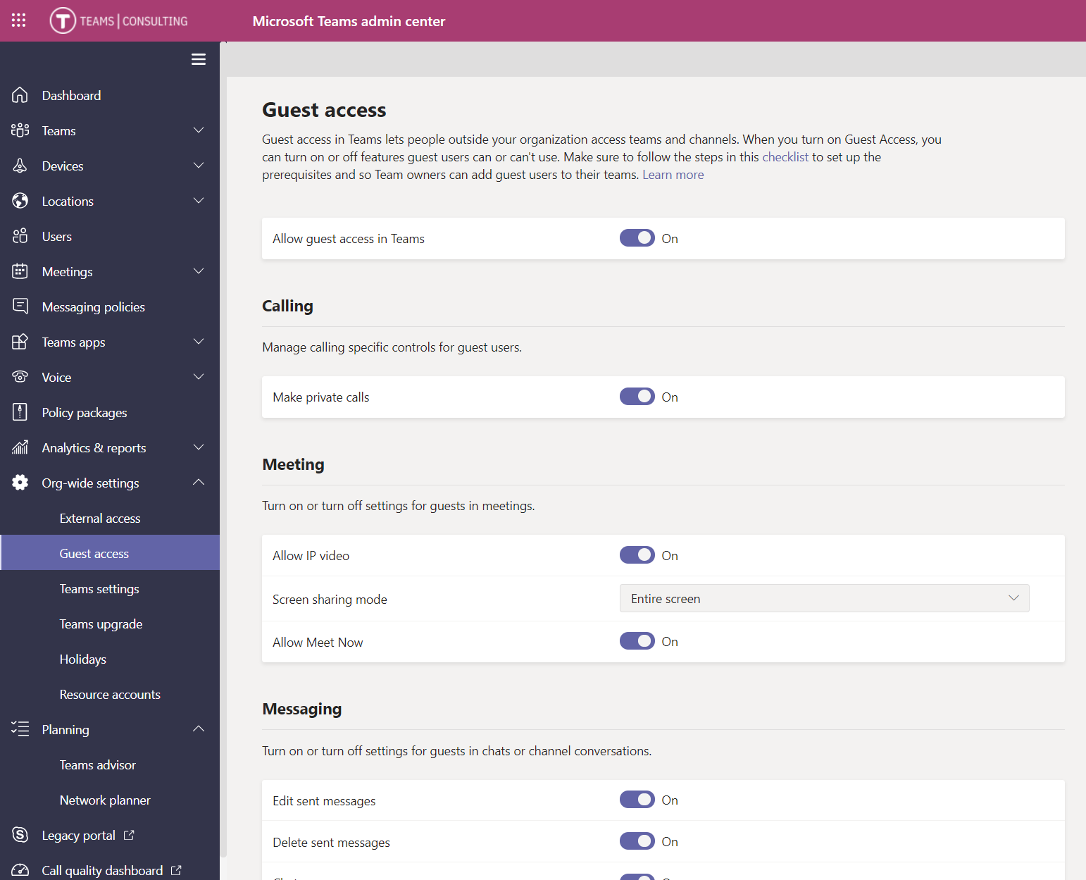
Enabling guest access: Step 3 – Check Teams Settings
Teams Admin Center-> Org wide settings -> Guest Access
Get-CsTeamsGuestMessagingConfiguration
Set-CsTeamsGuestMessagingConfiguration

Slide 17
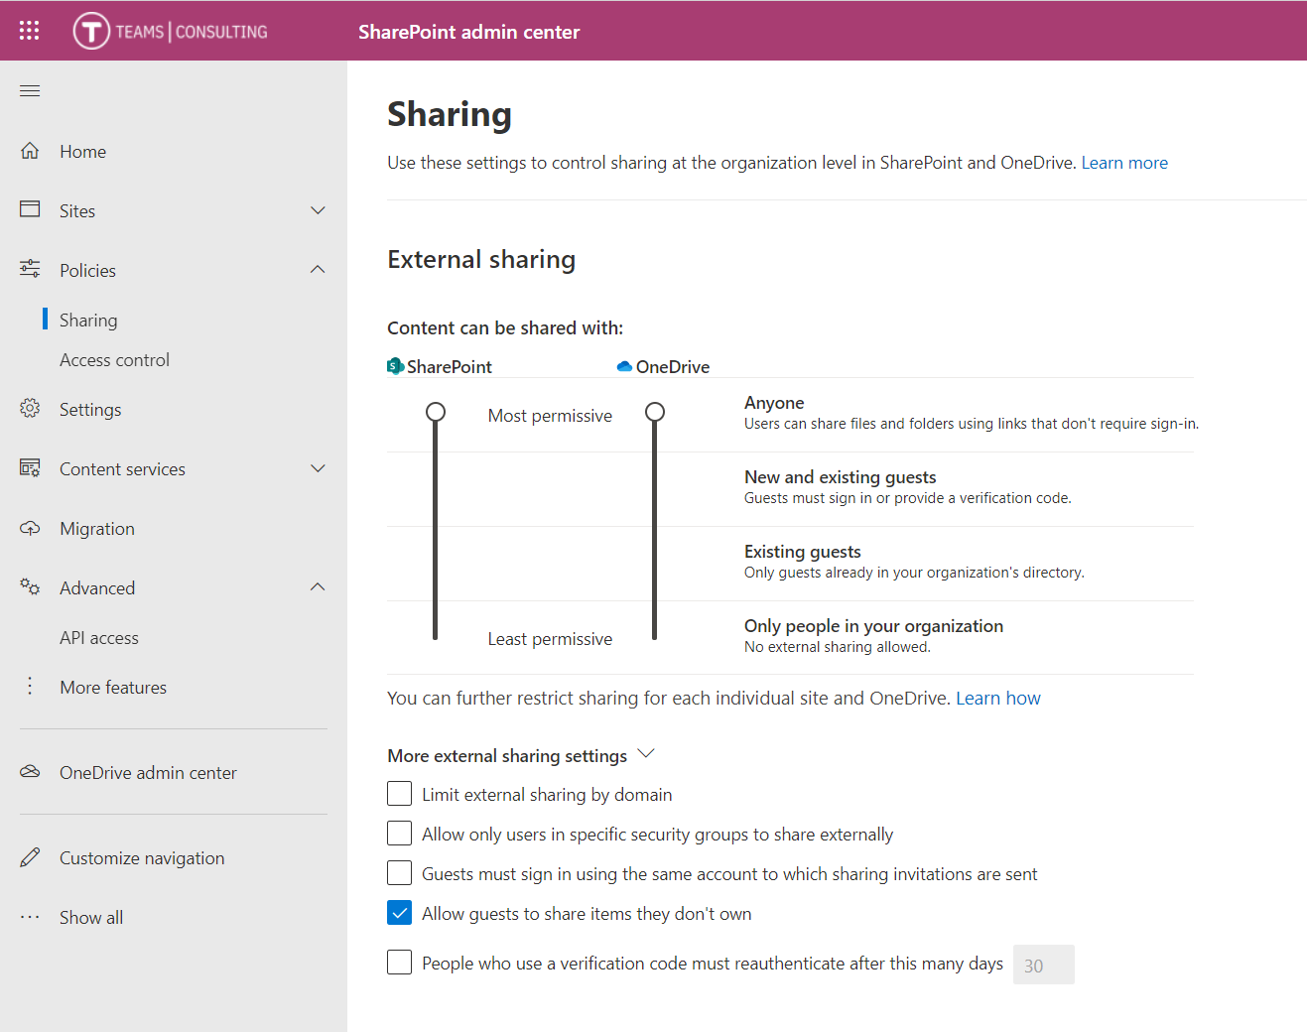
Enabling guest access: Step 4 – Check SharePoint Settings
SP Admin Center-> Policies -> Sharing

Slide 18
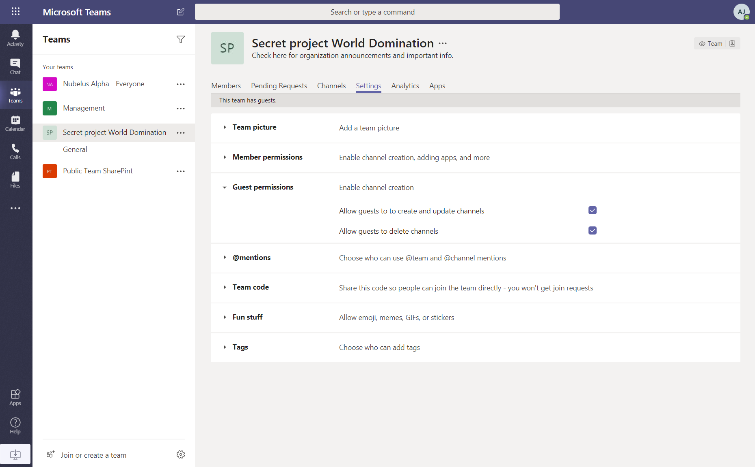
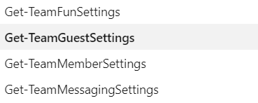

Enable guest permissions in each Team
Get-Team -GroupId "fc28d5c3-6090-41c7-b3e1-6792a3be6bce" | Format-List

Slide 19
HIGH LEVEL GROUPS-TEAMS USER ARCHITECTURE
Single Team
Azure AD Groups
Microsoft 365 Groups
Org-wide Teams Settings

Slide 20
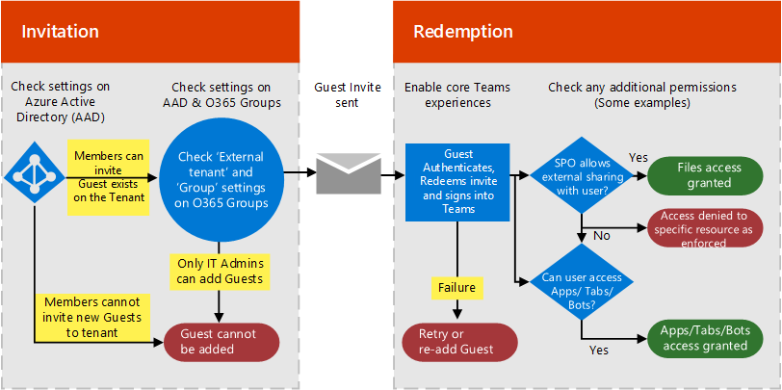
The guest invitation process

Slide 21
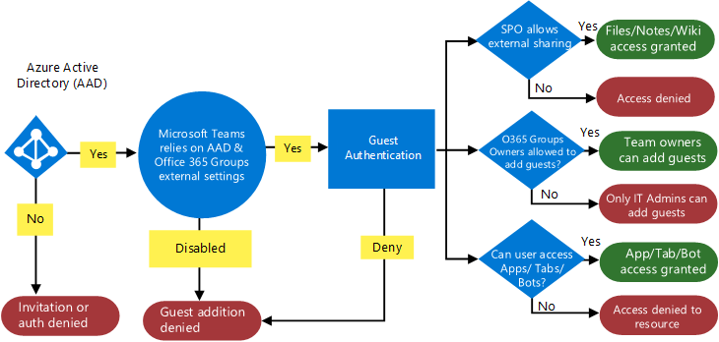
The guest auth flow.

Slide 22
Group membership is async: 20 min – 24 h
Azure Active Directory
Microsoft Teams

Slide 23
INTERESTING
ENABLING FEDERATION WITH GOOGLE

Slide 24
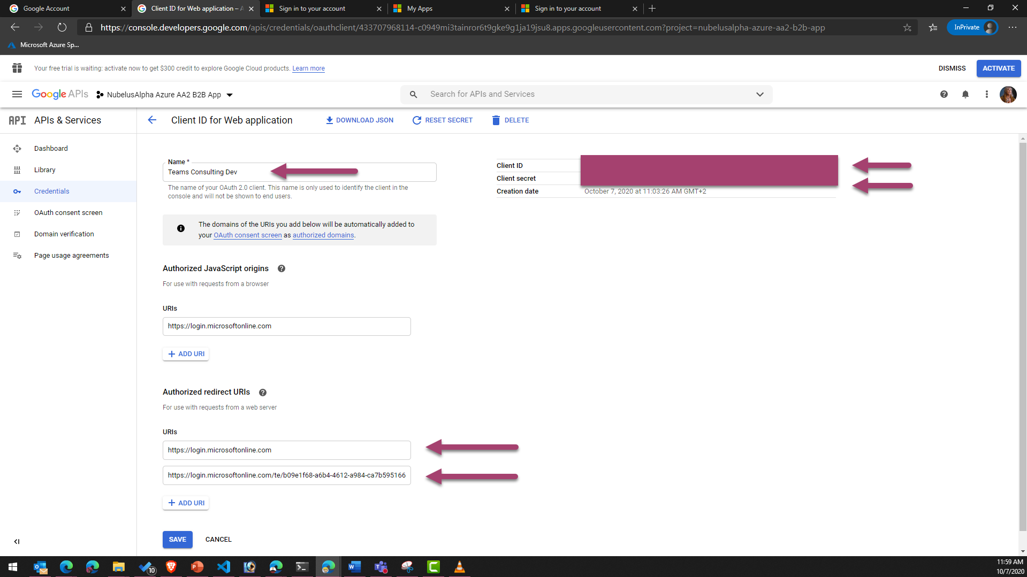

Slide 25
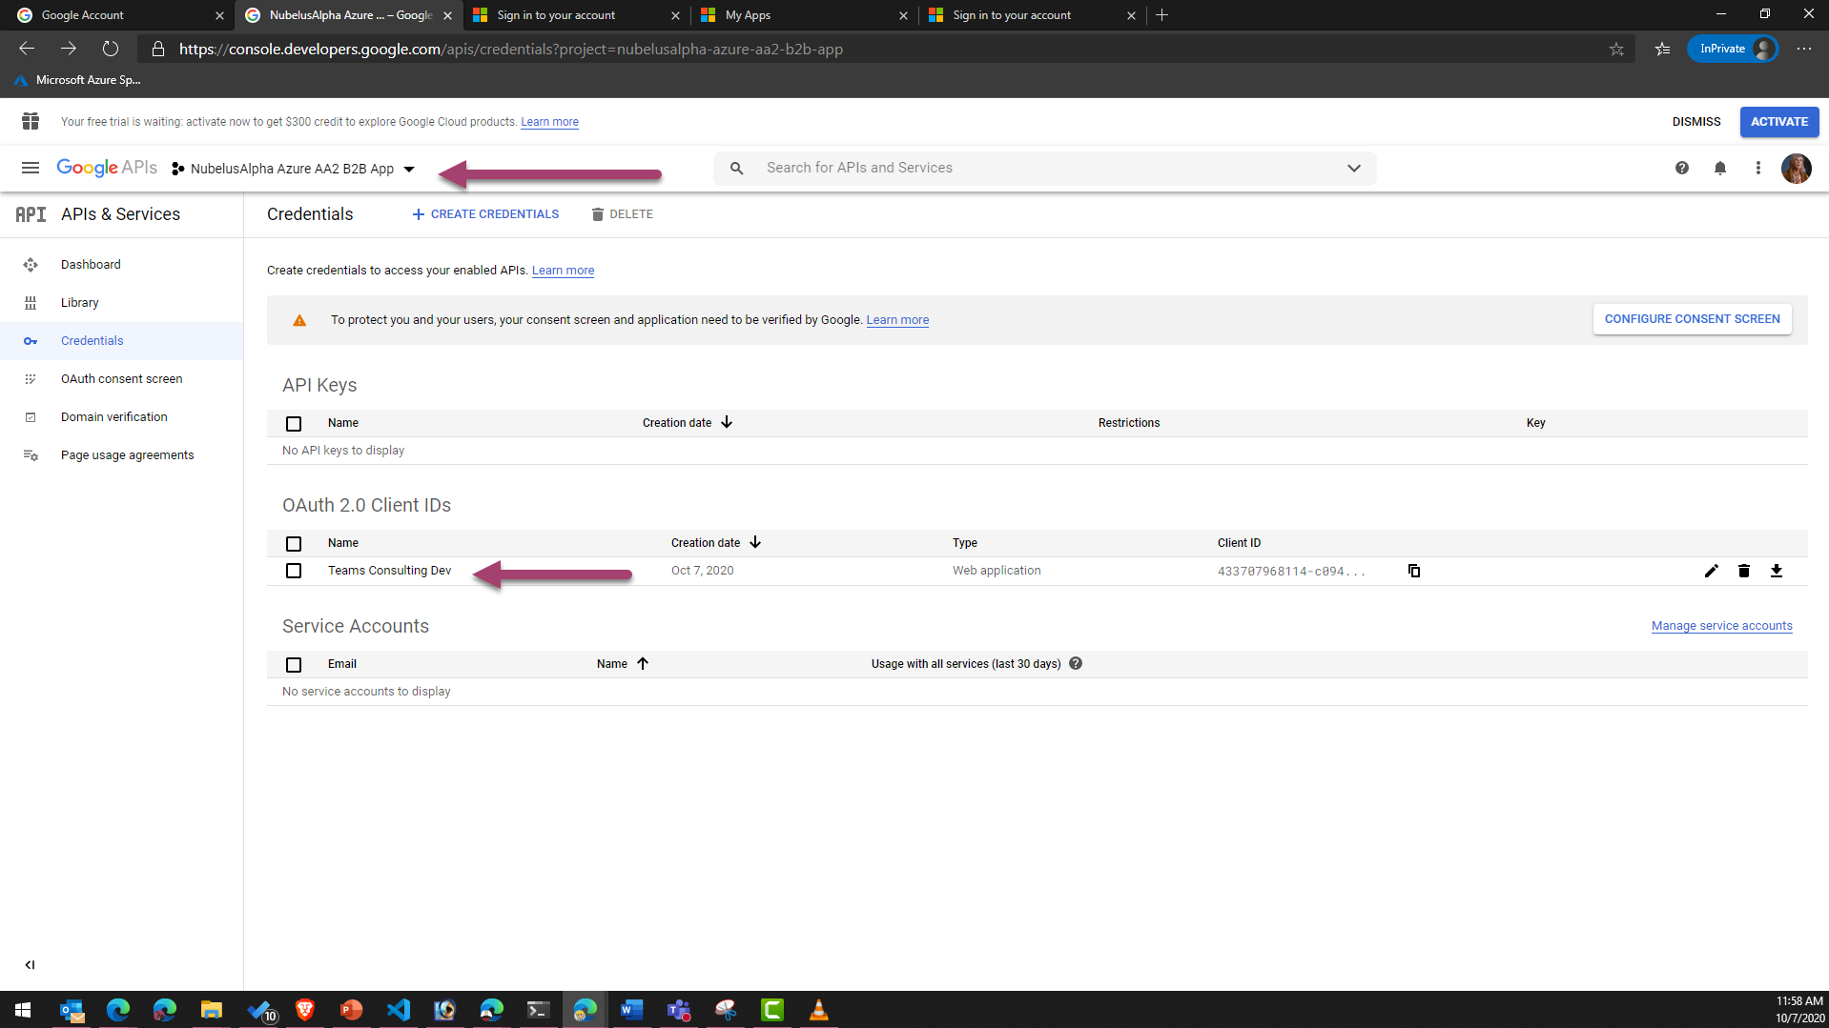

Slide 26
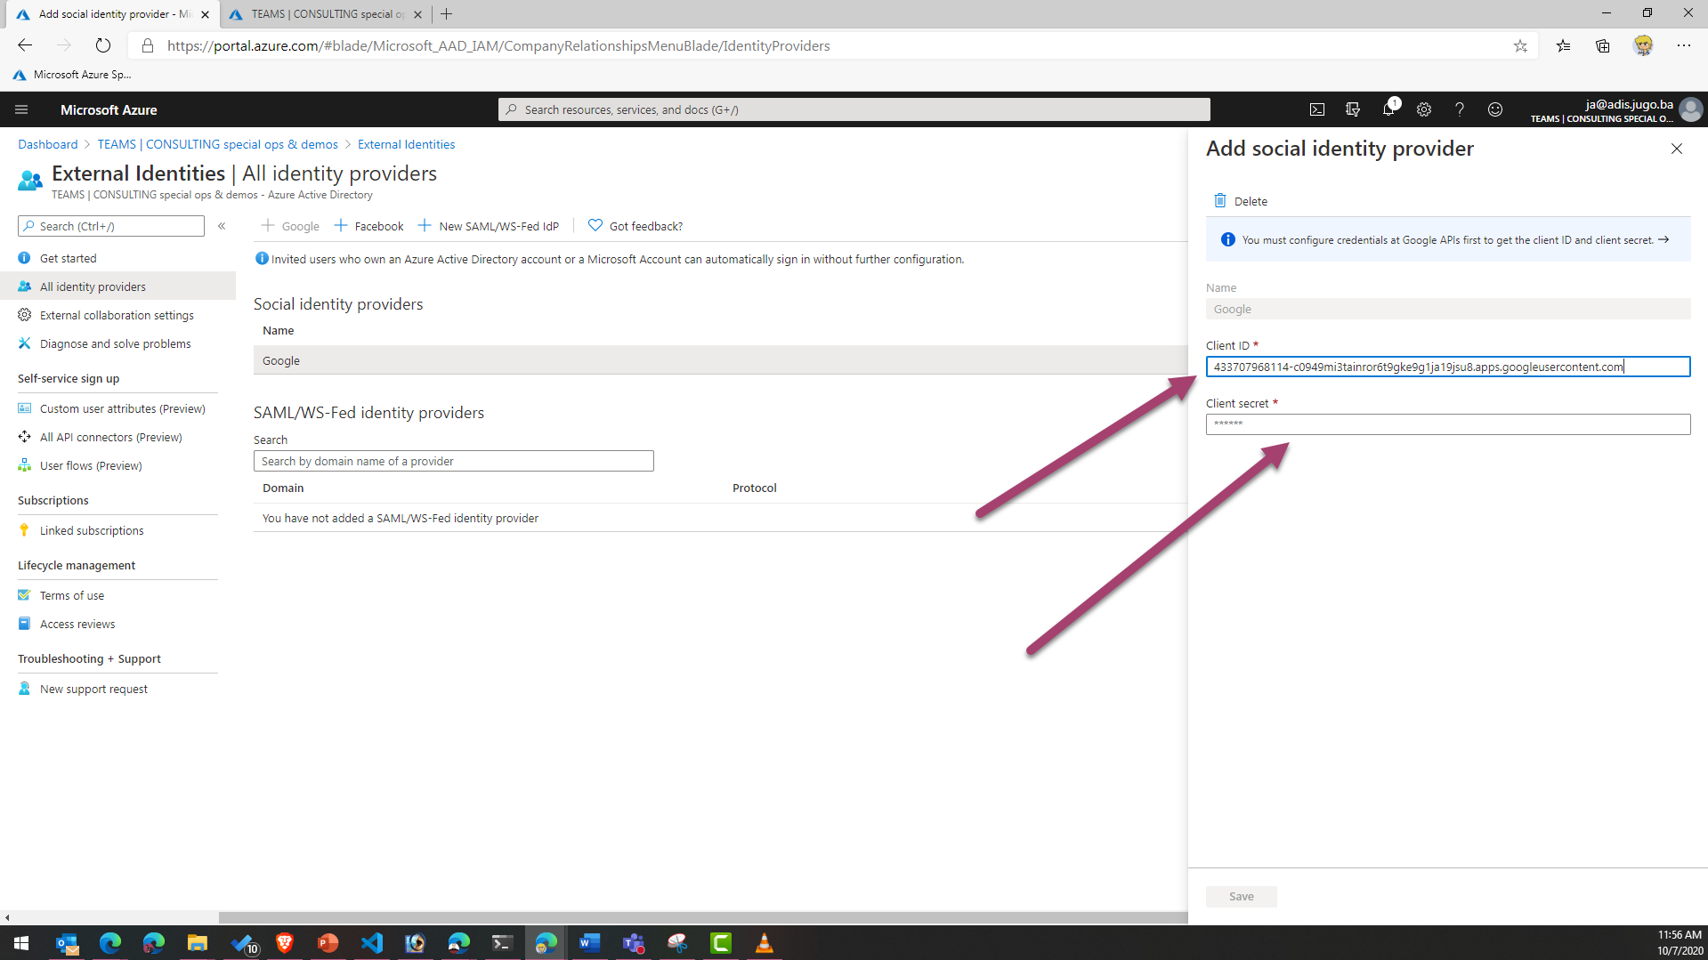

Slide 27
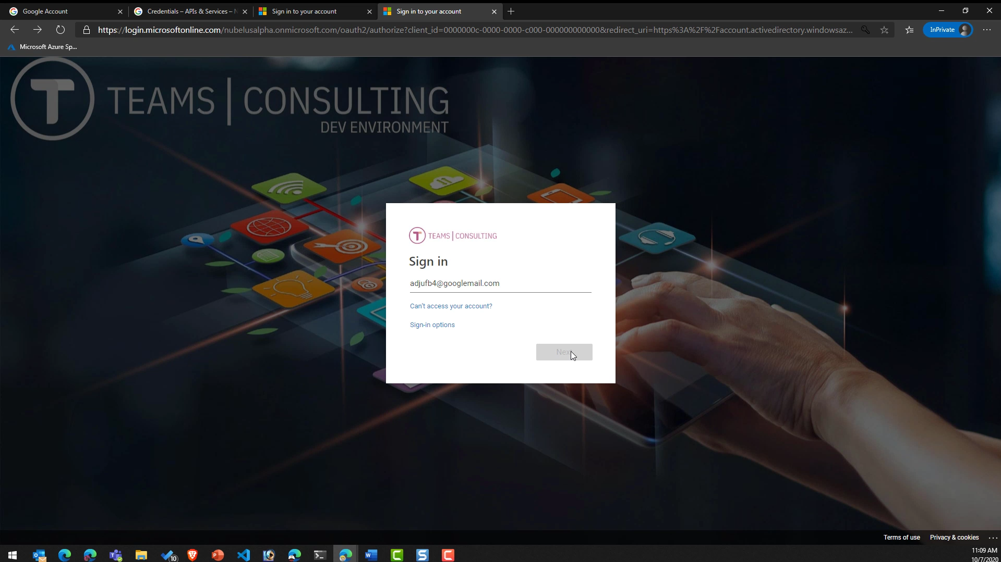

Slide 28
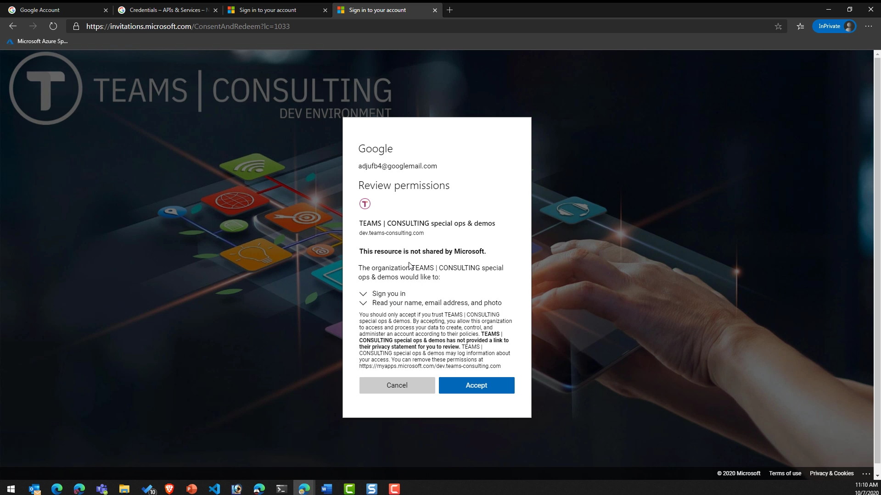

Slide 29
ACTION
MANAGING AND AUDITING USERS

Slide 30
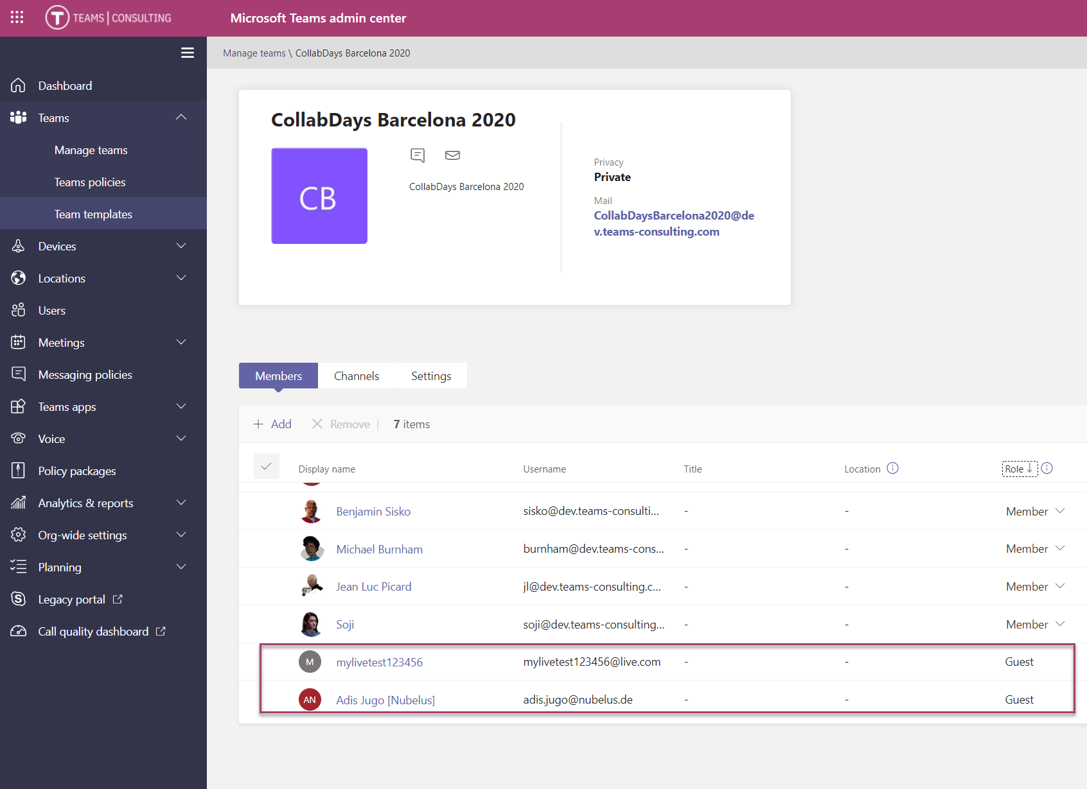
Managing Guests

Slide 31
GETTNG ALL TEAMS FOR AN USER
Get-Team -User "adis.jugo@nubelus.de"

Slide 32
Managing guests – UI or PowerShell
Install-Module MicrosoftTeams
Import-Module MicrosoftTeams
Connect-MicrosoftTeams
Get-team
Get-TeamUser -GroupId „***" | Where-Object {$_.Role -eq "Guest"}

Slide 33
Auditing guests – UI or PowerShell
//AUDIT GUESTS
Install-Module -Name ExchangeOnlineManagement
Import-Module -Name ExchangeOnlineManagement
$Cred = Get-Credential
Import-Module ExchangeOnlineManagement
Get-Module ExchangeOnlineManagement
$Cred = Get-Credential
Connect-ExchangeOnline -Credential $Cred -ShowProgress $true
Search-UnifiedAuditLog -EndDate "12-12-2020" -StartDate "01-01-2020" -ResultSize 5000 -UserIds "adis.jugo_nubelus.de#ext#@nubelusalpha.onmicrosoft.com"
Search-UnifiedAuditLog -EndDate "12-12-2020" -StartDate "01-01-2020" -ResultSize 5000 -UserIds „adis.jugo@nubelus.de"

Slide 34
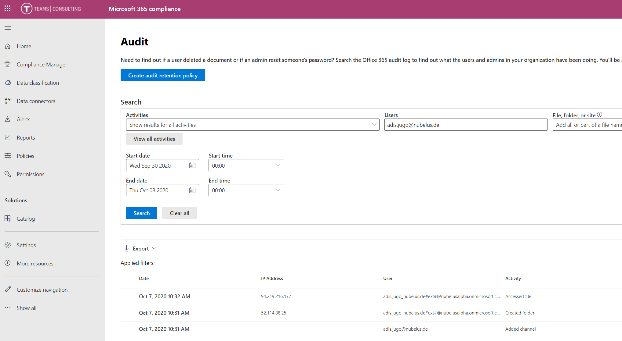
AUDITING GUESTS

Slide 35
IMPORTANT
When auditing external users, some of their events are logged under their original email address (user@domain.com), and some under their SAML User Principal Name (user_domain.com#EXT#@tenant.onmicrosoft.com)

Slide 36
AUDITING GUESTS
Install-Module -Name ExchangeOnlineManagement
$Cred = Get-Credential
Import-Module ExchangeOnlineManagement
Get-Module ExchangeOnlineManagement
$Cred = Get-Credential
Connect-ExchangeOnline -Credential $Cred -ShowProgress $true
Search-UnifiedAuditLog -EndDate "05-01-2020" -StartDate "04-29-2020" -ResultSize 5000 -UserIds "adis.jugo_nubelus.de#ext#@nubelusalpha.onmicrosoft.com"
Search-UnifiedAuditLog -EndDate "05-01-2020" -StartDate "04-29-2020" -ResultSize 5000 -UserIds „adis.jugo@nubelus.de"

Slide 37




RECAP
You need to know your external and guest users – who are they, where are they, and what are they doing
Active control external and guest user settings
Management and reporting
Settings
Management Reporting
Federations
Auditing
Enabling and controlling federations
e.g. Google
Auditing

Slide 38
THANK YOU
IF THERE ARE ANY QUESTIONS, PLEASE DO NOT HESITATE TO CONTACT ME
Adis Jugo adis.jugo@teamsconsulting.eu twitter: @adisjugo

Slide 39
Our Sponsors
DIAMOND
COMMUNITY

Slide 40


